Slide 1
GAC Opening Plenary Session

Slide 2
Welcomes
Welcome from GAC Chair – Nicolas Caballero
2. Welcome from Host Country Government –
Benjamin Brake, Director-General for Digital and Data Policy in the Federal Ministry for Digital and Transport
Notes:
You can also call him Ben Brake (that‘s how he registered)
Pronunciation of the last name is Brah - ke

Slide 3
3. GAC Meeting Overview
Review of Weekly Agenda by GAC Chair
Review of Meeting Logistics by ICANN GAC Support staff
Tour de Table (in-person and remote GAC participants)
Notable GAC Activities since ICANN77
GAC Communiqué Development for ICANN78
Results of 2023 GAC Vice Chairs Election
Notes:
NOTE that, time permitting, these topics will be covered in this session

Slide 4
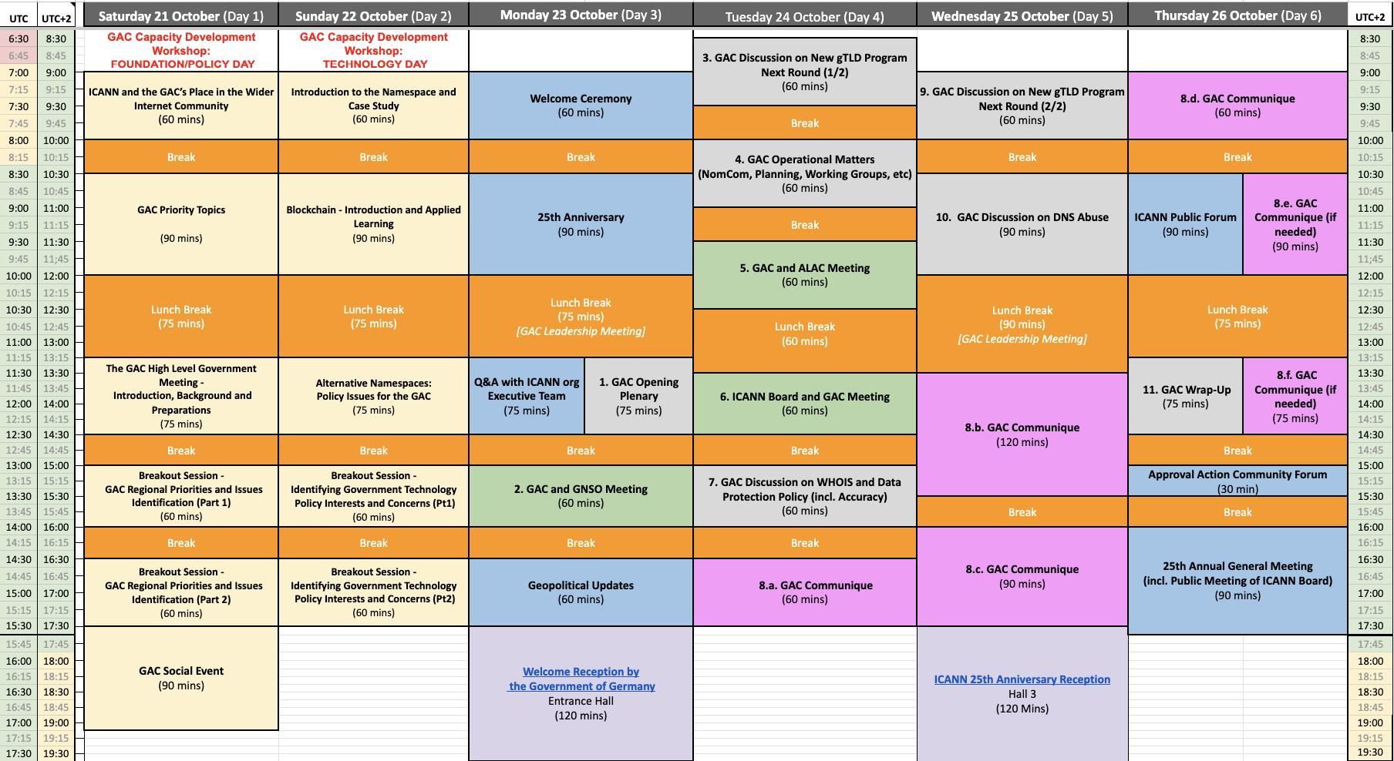
3. Review of Weekly Agenda

Slide 5
4. Review of Meeting Logistics
Notes for All Attendees
Zoom Session Infrastructure and Protocols:
Before the session
Calendar Invites in advance (24-hour link info)
Session pages on GAC website for materials
During the session
Requesting Floor Procedure (all on-site and virtual participants)
Raise Hand via Zoom room
Turn on video; Turn on microphone
Interpretation - 6 UN Languages
Available through Zoom system; pick Language in Zoom
Interpreters working remotely
Identify yourself and speak slowly and clearly for scribes and interpreters
After the session
Recordings and transcripts available on GAC web site
Notes for In-person Attendees
Reserved GAC delegation seats at table microphones
Observers welcomed on seats on right and left side
Seats will be reserved in front rows for some sessions
Health and Safety Protocols (masks by choice, distancing, breaks)
Notes:
Gulten to Present

Slide 6
3. ICANN74 - Overview of Logistics and Technical Capabilities
Notes:
Gulten to Present

Slide 7
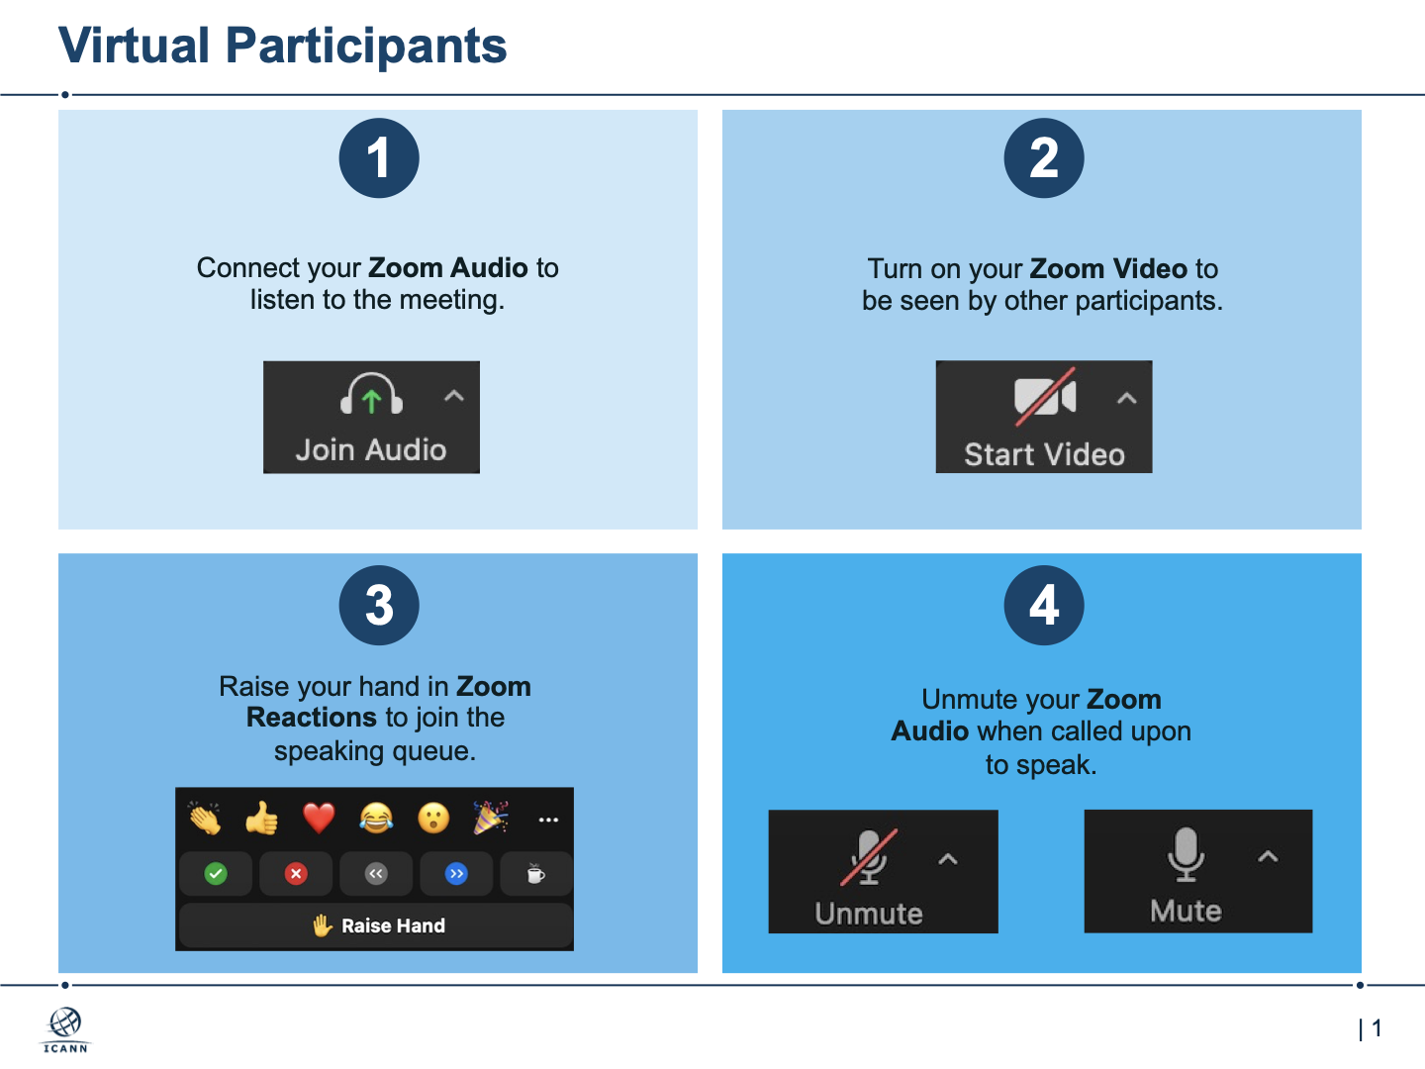
3. ICANN74 - Overview of Logistics and Technical Capabilities
Notes:
Gulten to Present

Slide 8
5. Tour de Table
The GAC Chair will open the floor to GAC representatives and delegates to introduce themselves and share any short comments or statements they would like to make.
Introductions will then follow the table seating within the GAC meeting room.
After in-room attendees have introduced themselves, remote participants will be invited to raise their hands in the Zoom room and provide their own introductions when recognized.

Slide 9
6. Notable Developments Since ICANN77
GAC Correspondence (6 Incoming - 4 outgoing)
Four (4) Public Comment Contributions
~ 85 New GAC Participants in 2023 calendar year so far
~ 28 New GAC Participants since ICANN77
Decision to Move Forward with HLGM at ICANN80 - Kigali, Rwanda
Chair and Vice Chair Discussions about operational improvements and planning for annual work planning and longer-term strategic planning
Notes:
Assuming Time is left - Feel free to read slide and add personal perspectives
Looking forward to a productive week with you all.

Slide 10
7. Communiqué Development for ICANN78
ICANN78 Meeting Week
Communiqué Drafting Phase
Communiqué
Preparation
Phase
Monday
Meeting Day 3
Communiqué
Process Introduction
Wednesday
Meeting Day 4
Plenary Sessions + Communiqué
Drafting 1
Wednesday
Meeting Day 5
Plenary Sessions
+ Communiqué
Drafting 2 & 3
Thursday Meeting Day 6
Communiqué
Drafting 4 (5 & 6)
72-hour Communiqué
Review Period
Continuous consideration of Communiqué at the end of GAC Plenary Sessions
Decision by GAC Chair, based on advancement of Drafting, to close live collaboration on the document in the interest of clarity and stability of the text
Draft Communiqué Google Doc
Open for live contributions by GAC Members
Draft Communiqué Google Doc
Edited only through GAC Support Staff
Drafters of Communiqué Text are encouraged, at any stage of Communiqué dévelopment, to use the GAC Support Team as a resource to research precedent, ensure accuracy of references and consistency with usual practice as needed
Notes:
Thank you all for introducing yourselves. Very glad to have everyone present here in-person and on-line
As I noted earlier, the production of the GAC Communique is one of, if not THE, biggest work product of the committee at each of our public meetings
The Communique communicates to the ICANN Board, the rest of the ICANN community, and frankly the rest of the world, our government priorities regarding DNS policies in the form of information, issues of importance, and, where appropriate, specific GAC Advice to the ICANN Board.
As such, a drafting and production process has evolved over time to maximize the committee’s effectiveness and efficiency in developing the document.
This week that process will be challenged by our time constraints and the fact that it will be my first time managing the process.
To provide us with some context for the work, I’d like Fabien Betremieux of the GAC Support staff to help me outline the process we’re going to employ this week.
Fabien, go ahead.

Slide 11
7. Communiqué Development for ICANN78
Distribution of Communiqué drafting sessions during the ICANN meeting over 3 days to maximize opportunities for national consultation with capitals in other timezones, as well as review of precedents and references by GAC Support staff.
Communique Pre-Meeting Consideration Phase prior to the meeting week, to enable appropriate consultations in advance of the meeting. For ICANN78:
Issue Identification Phase: 9-13 October 2023 (identification of potential topics for GAC Advice)
Communiqué Preparation Phase: 16-20 October 2023 (for proposals of key messages and GAC Advice text)
Communiqué “touch point” at the end of every GAC plenary session to assist in the timely formulation of Communiqué text proposals and to facilitate identification of pen holders who would like to be involved in the initial stages of drafting
72-hour review period after adoption of the Communiqué in recognition that the virtual/hybrid environment may impede participation for some GAC Members and Observers (including due to connectivity issues and timezone challenges)

Slide 12
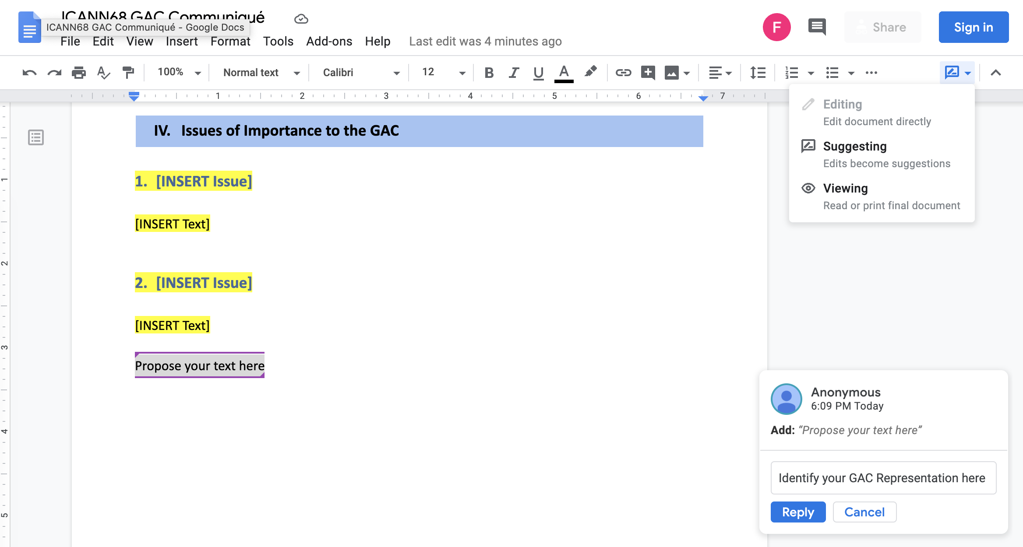
7. Communiqué Development for ICANN78
1
1. Make sure you are
in “suggesting” mode
(should be by default)
2
3. Identify Author
(GAC Representation
or Group of drafters)
3
2. Propose you text
where appropriate
4. Don’t forget to hit “Reply”
otherwise your edits will not
be identified
4
Notes:
During Issue identification phase (2 Weeks Prior to ICANN7X) members are invited to circulate their proposed issues and associated key messages on gac@icann.org
During Communiqué Preparation (1 Week Prior to ICANN7X) and during the ICANN meeting, members may propose text directly in the Google collaborative document

Slide 13
GAC Operational Matters – 2023 Vice Chairs Election Results

Slide 14
GAC 2023 Vice Chairs Election
Eight (8) candidates for 5 seats
Pär Brumark (Niue)
Zeina Bou Harb (Lebanon)
Thiago Dal-Toe (Colombia)
WANG Lang (China)
Ken-Ying Tseng (Chinese Taipei)
Tomboye Ibrahim Mahamat Itno (Chad)
Nigel Hickson (United Kingdom)
Christine Arida (Egypt)
Balloting period ended 23:59 UTC on Sunday 22 October
Electronic (Tally system) Election/Voting system worked reliably
Quorum requirements of GAC Operating Principle #32 have been met (119 ballots submitted and recorded). Thank you to all voters.
Thank you to all the candidates for your willingness to serve
No ties that would prohibit identifying the candidates with the five highest vote counts - (further balloting not needed)

Slide 15
GAC Vice Chair Election Results
Based on the votes cast, the elected 2023 GAC Vice Chairs will be:
Nigel Hickson (United Kingdom) (2nd term)
WANG Lang (China) (2nd term)
Zeina Bou Harb (Lebanon) (2nd term)
Christine Arida (Egypt) (1st term)
Thiago Dal-Toe (Colombia) (1st term)
Official one-year vice chair terms start after ICANN79 and go until end of ICANN82
New vice chairs will be invited to attend upcoming leadership calls (after Hamburg meeting) to assist in onboarding and transitioning
Thank you to all the candidates and voters

